Slide 1
Lab 1: Automatic Speech Recognition
Ying shen and deng hao
School of software engineering
tongji university

Slide 2
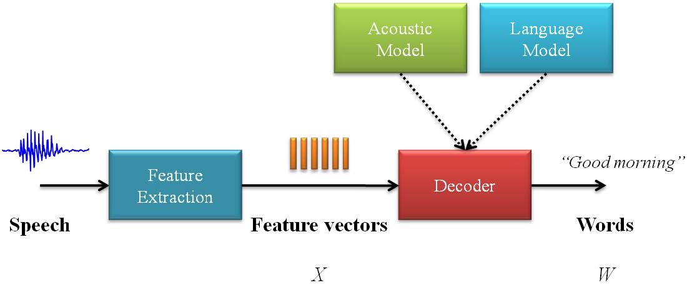
Architecture of an ASR system

Slide 3
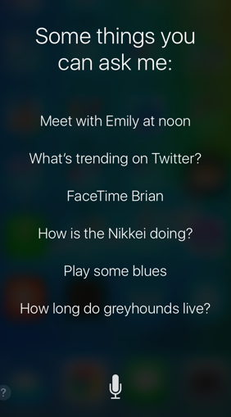
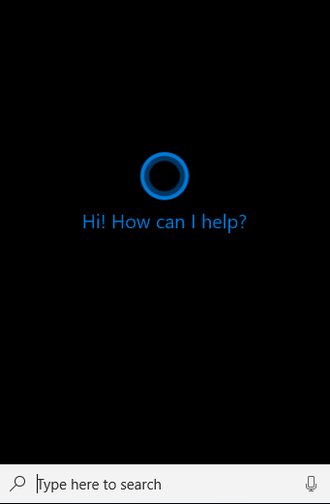
Voice UI
Notes:
现在语音交互VUI触发的常见类型有：
（1）语音触发：例如iphone配置的siri
（2）触觉触发：按下按钮或者切换空间
（3）动作触发：在传感器前完成某种手势动作
（4）设备自己触发：事先预定好的设置触发设备

Slide 4
Introduction to Python and Pypi
A handful of packages for speech recognition exist on PyPI
apiai
assemblyai
google-cloud-speech
pocketsphinx
SpeechRecognition
watson-developer-cloud
Official site of SpeechRecognition: https://pypi.org/project/SpeechRecognition/

Slide 5
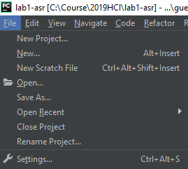
Install SpeechRecognition
Create a new project in Pycharm
Open “File->settings” from the menu bar

Slide 6
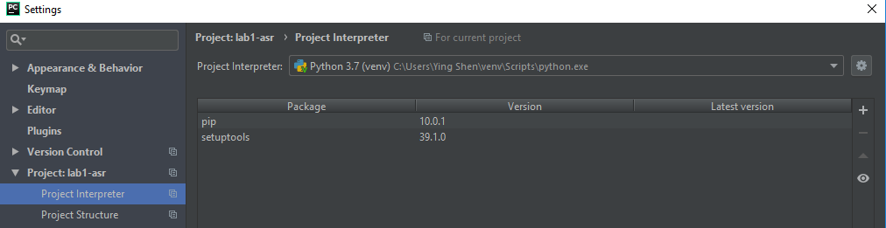
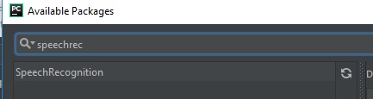
Install SpeechRecognition
Click “+” icon
Input “SpeechRecognition” in the search box and select

Slide 7
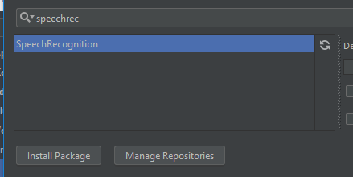
Install SpeechRecognition
Install SpeechRecognition package by clicking the button

Slide 8
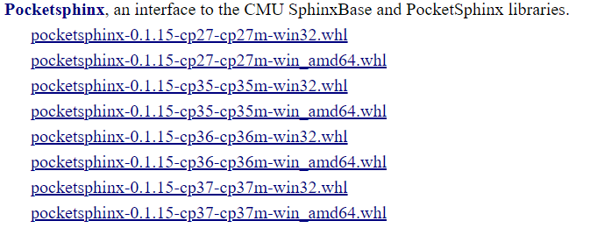
Install PocketSphinx (Windows)
Download right binary library from https://www.lfd.uci.edu/~gohlke/pythonlibs/#pocketsphinx

Slide 9
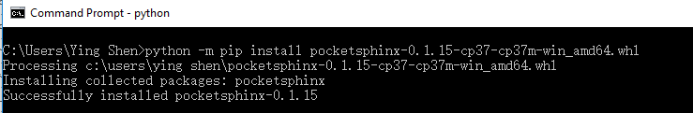
Install PocketSphinx (Windows)
Install .whl file in command window using the following command
python -m pip install pocketsphinx‑downloaded_wheel.whl

Slide 10
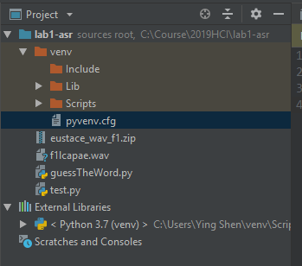
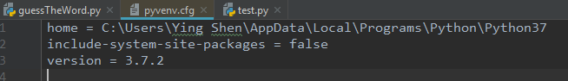
Install PocketSphinx
Configure Pycharm
Edit pyvenv.cfg in Pycharm
Restart Pycharm
true

Slide 11

Test PocketSphinx
Test
Create a new Python file and type in the following codes
Run the codes
import speech_recognition as sr r = sr.Recognizer() speech = sr.AudioFile('f1lcapae.wav') with speech as source: audio = r.record(source) print(r.recognize_sphinx(audio))

Slide 12
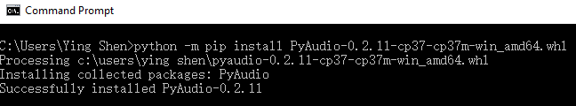
Install PyAudio (Windows)
Download right binary library from
https://www.lfd.uci.edu/~gohlke/pythonlibs/#pyaudio
Install .whl file in the command window using the following command
python -m pip install PyAudio‑downloaded_wheel.whl

Slide 13
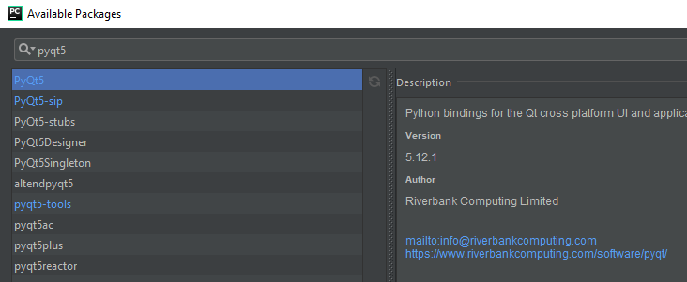
Install PyQt5
Install PyQt5

Slide 14
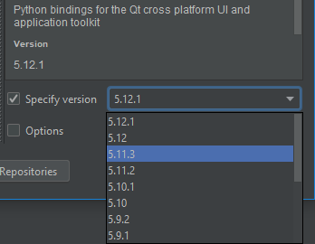
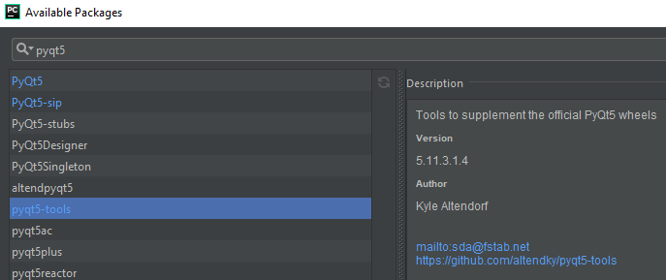
Install pyqt5-tools (optional)
If you want to use PyQt5 Designer (pyqt5-tools) to graphically design the form, you should install PyQt5 v. 5.11, because pyqt5-tools doesn’t support v. 5.12 of PyQt5.
To install pyqt5-tools
Install v. 5.11.3 of PyQt5
Then install pyqt5-tools
Notes:
You can also download wheel file of pyqt5-tools from https://pypi.org/project/pyqt5-tools/#files and install the package using pip

Slide 15
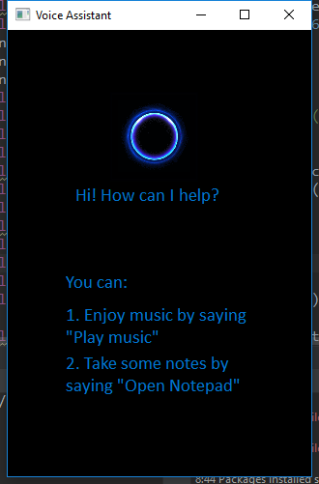
Interface of assignment1
Requirements:
The program could receive user’s voice command, recognize the content and finish the task
Assume commands are correctly spoken
Input:
A voice command from the user
Output:
Finish the task

Slide 16
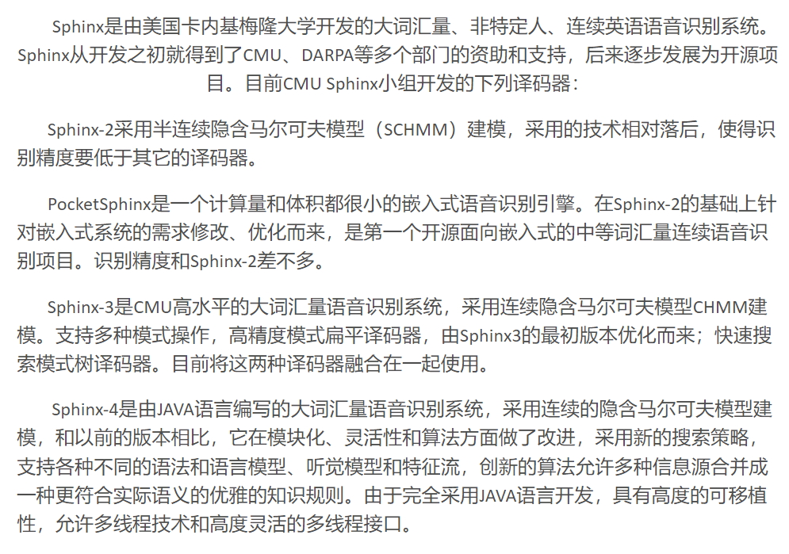
Install PocketSphinx (Linux)
In Terminal, run:
sudo apt-get install libpulse-dev
sudo apt-get install libasound2-dev
sudo apt install swig
sudo pip3 install pocketsphinx (“pip” for python2)

Slide 17
Install PyAudio (Linux)
In Terminal, input:
sudo apt-get install python-pyaudio python3-pyaudio

Slide 18
Install PyAudio (Mac OS X)
Use Homebrew to install the prerequisite portaudio library, then install PyAudio using pip:
brew install portaudio
pip install pyaudio
Notes:
If not already installed, download Homebrew.
pip will download the PyAudio source and build it for your version of Python.
Homebrew and building PyAudio also require installing the Command Line Tools for Xcode (more information).
Ref: http://people.csail.mit.edu/hubert/pyaudio/

Slide 19
Assignment
Run test.py and guessTheWord.py. Get familiar with the program.
Add two functions to the program (asr.py), such as
Play music
(tips: win32api.ShellExecute(0, 'open', 'E:\\song.wma', '','',1))
Open a text file
(tips: win32api.ShellExecute(0, 'open', 'notepad.exe', '','',0))
Any other function you’d like to implement
You can find many examples of how to call external commands in python on the web

Slide 20
Report
The report should answer the following questions:
The modifications to GUI and the codes
The accuracy of speech recognition and how to improve it, if possible?
Submit your work (code and report)
Prepare a readme file to illustrate how to run your program
Compress all the codes and the report into a zip file: ID_name_lab1.zip
Email address: timcan@foxmail.com
4月29日前，迟交1天扣1分

